Slide 1




NEXT GEN EMPLOYABILITY PROGRAM
Creating a future-ready workforce
Loyola-ICAM College of engineering and technology
Team Members
Student Name :Mirunalini
Student ID :au311121205037
Chennai

Slide 2

CAPSTONE PROJECT SHOWCASE
Project Title
Music Web Application using Django Framework
Abstract | Problem Statement | Project Overview | Proposed Solution | Technology Used | Modelling & Results | Conclusion

Slide 3
Abstract
This initiative aims to create a dynamic web application for music, built on the Django framework. The goal is to offer a comprehensive platform for users to discover, manage, and enjoy musical content. The application prioritizes user-focused design, providing smooth user registration and authentication, thereby ensuring secure access to personalized features and settings. Users will be able to access a vast music library, allowing them to explore, search, and immerse themselves in a wide array of tracks, albums, and artists. Furthermore, the application enables users to create their own custom playlists, making it easier to organize and access their favorite music. Taking advantage of Django’s powerful features, the application will also provide seamless music streaming directly from the platform, removing the need for any external software or plugins.
Source :

Slide 4
Problem Statement
The issue stems from the disjointed state of existing online music platforms, which do not provide a unified solution for personalized music discovery, organization, and social engagement. Users struggle to access customized recommendations and efficiently manage their music libraries, while the lack of strong social features hinders their interaction with others. To tackle these challenges, this project is set to create a holistic music web application using the Django framework. By incorporating features like personalized playlist creation, custom music recommendations, and dynamic social interaction capabilities, the application aims to provide users with a smooth and immersive music discovery journey, thereby bridging the gap in the current online music scenario.
Source :

Slide 5
Project Overview
This project involves creating a powerful music web application using the Django framework, aiming to offer users an engaging and personalized music exploration experience. The application will include features such as user registration and authentication, an extensive music library, the ability to create personalized playlists, music streaming, recommendation systems, and social interaction capabilities. With user-friendly interfaces and responsive design, the platform is designed to ensure easy access across various devices. By harnessing the robust capabilities of Django, the project aims to tackle the disjointed nature of current music platforms by providing a unified solution for discovering, managing, and interacting with music content. With a focus on improving user engagement and satisfaction, the project seeks to foster a lively and dynamic music community, thereby addressing the shortcomings in the existing online music environment.
Source :

Slide 6
Proposed Solution
The proposed project involves the creation of a comprehensive music web application using the Django framework, aimed at enhancing music discovery, organization, and social interaction. The application will feature a user-friendly interface with smooth navigation, enabling easy access to a wide-ranging music library. Essential features will include user authentication for personalized experiences, an extensive music catalog with search and browse capabilities, and the ability to create custom playlists. The application will also incorporate a recommendation system that uses user preferences and listening history to provide tailored music suggestions. Social interaction features like liking, commenting, and sharing will promote community engagement and aid music discovery among users. By emphasizing responsiveness and scalability, the proposed project aims to provide a unified and immersive music experience accessible on various devices, thereby addressing the limitations of current music platforms and improving user satisfaction
.
Source :

Slide 7
SOLUTION:
To address the challenges faced by users in the current music landscape, we propose the development of a comprehensive music web application using the Django framework. This application will be designed to streamline the process of music discovery, organization, and social interaction.
Key features of the application will include:
User Registration and Authentication: This will ensure secure access to personalized features and preferences.
Comprehensive Music Library: Users will have access to a vast array of tracks, albums, and artists, enabling them to explore and discover new music.
Personalized Playlist Creation: Users will be able to curate their own playlists, facilitating easy access to their favorite songs.
Music Streaming: The application will offer seamless music streaming directly from the platform, eliminating the need for external software or plugins.

Slide 8



Technology Used
Front-end
Back-end
Source :

Slide 9
Modelling & Results
Modelling & Results
Data Modelling:
The project begins with data modelling, defining the database schema using Django's ORM (Object-Relational Mapping).
Entities such as User, Playlist, Song, and Artist are modelled, with appropriate relationships established to represent user interactions and music content organization.
Customizations such as defining primary keys and optimizing database queries are implemented to ensure efficient data storage and retrieval.
Implementation and Results:
Following data modelling, the implementation phase focuses on building features to enable music discovery, organization, and social interaction.
User registration and authentication functionalities are developed to provide personalized experiences and secure access to the application.
A comprehensive music library is implemented, allowing users to browse, search, and explore a vast collection of songs, albums, and artists.
Personalized playlist creation features enable users to curate their own collections of favorite songs, while recommendation systems suggest relevant music based on user preferences and listening history.
Source :

Slide 10
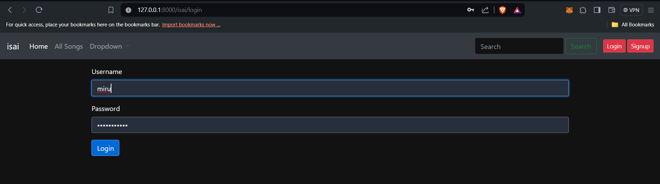

Slide 11
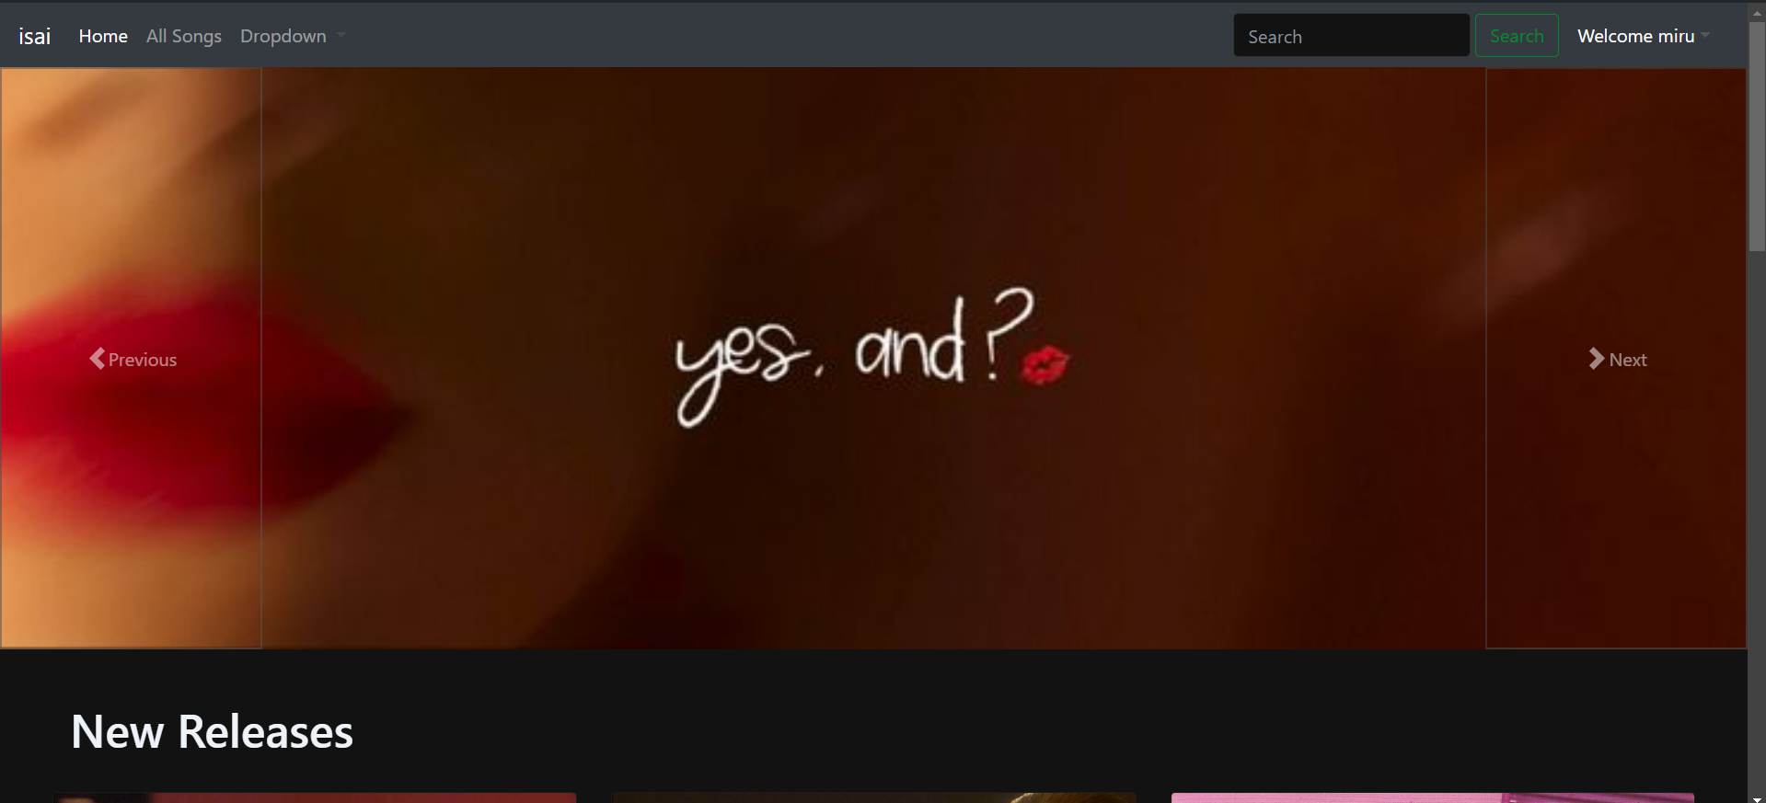

Slide 12
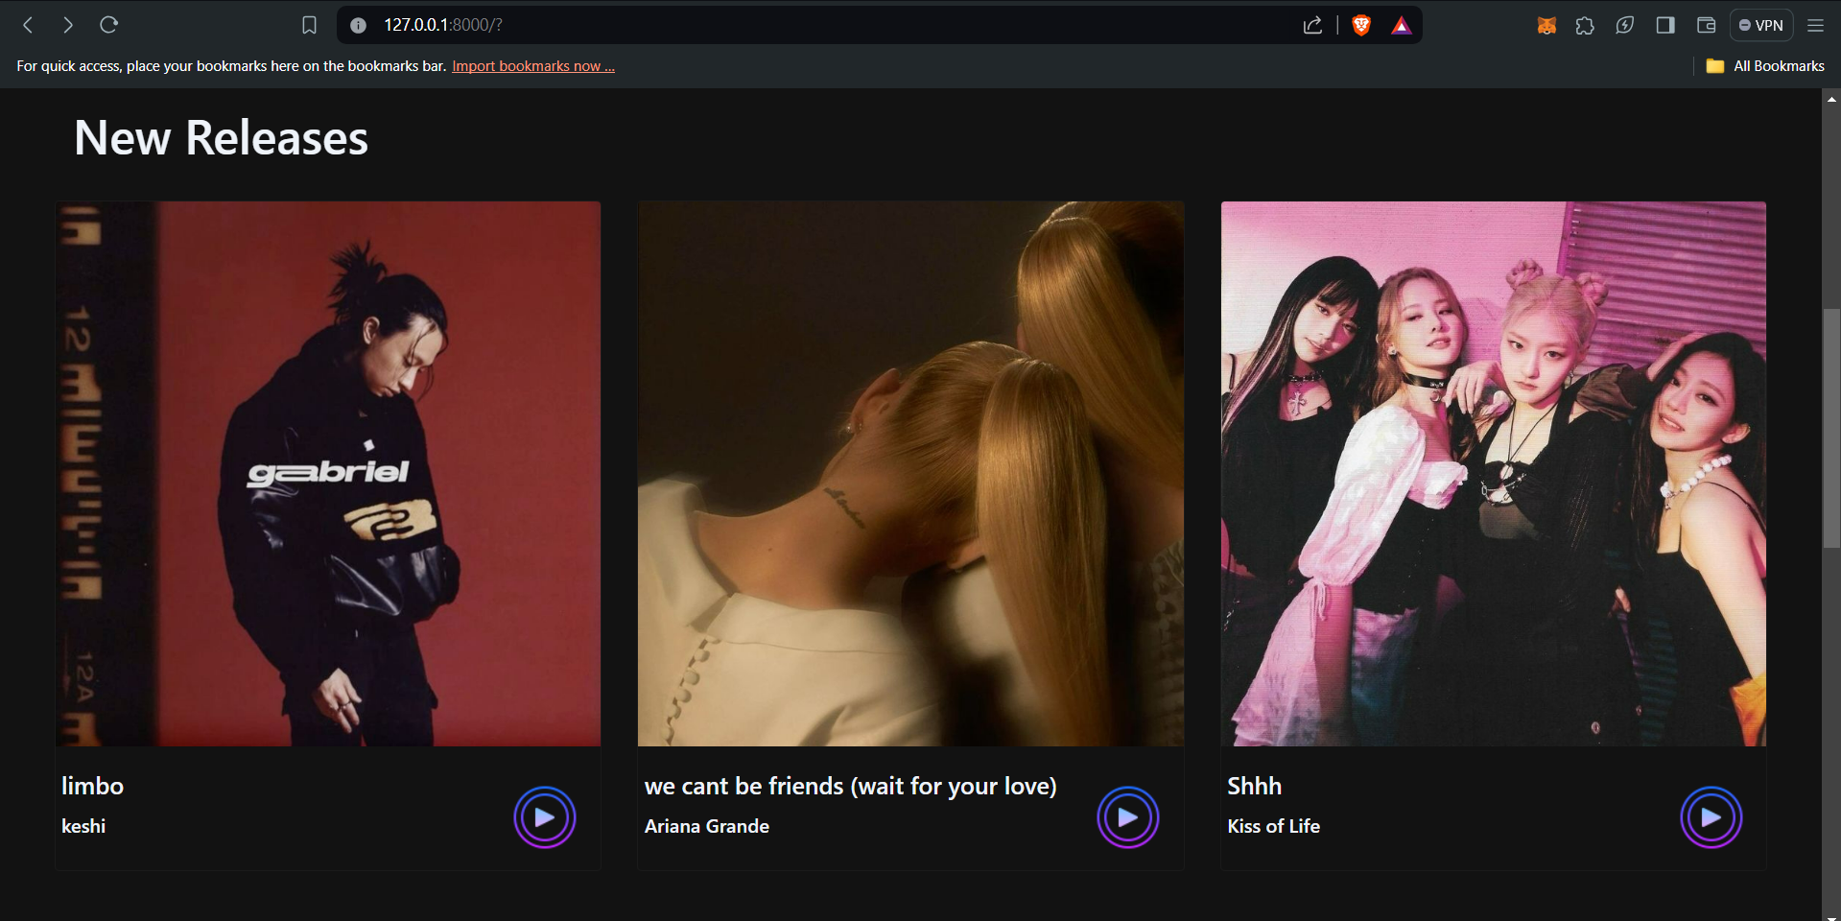

Slide 13
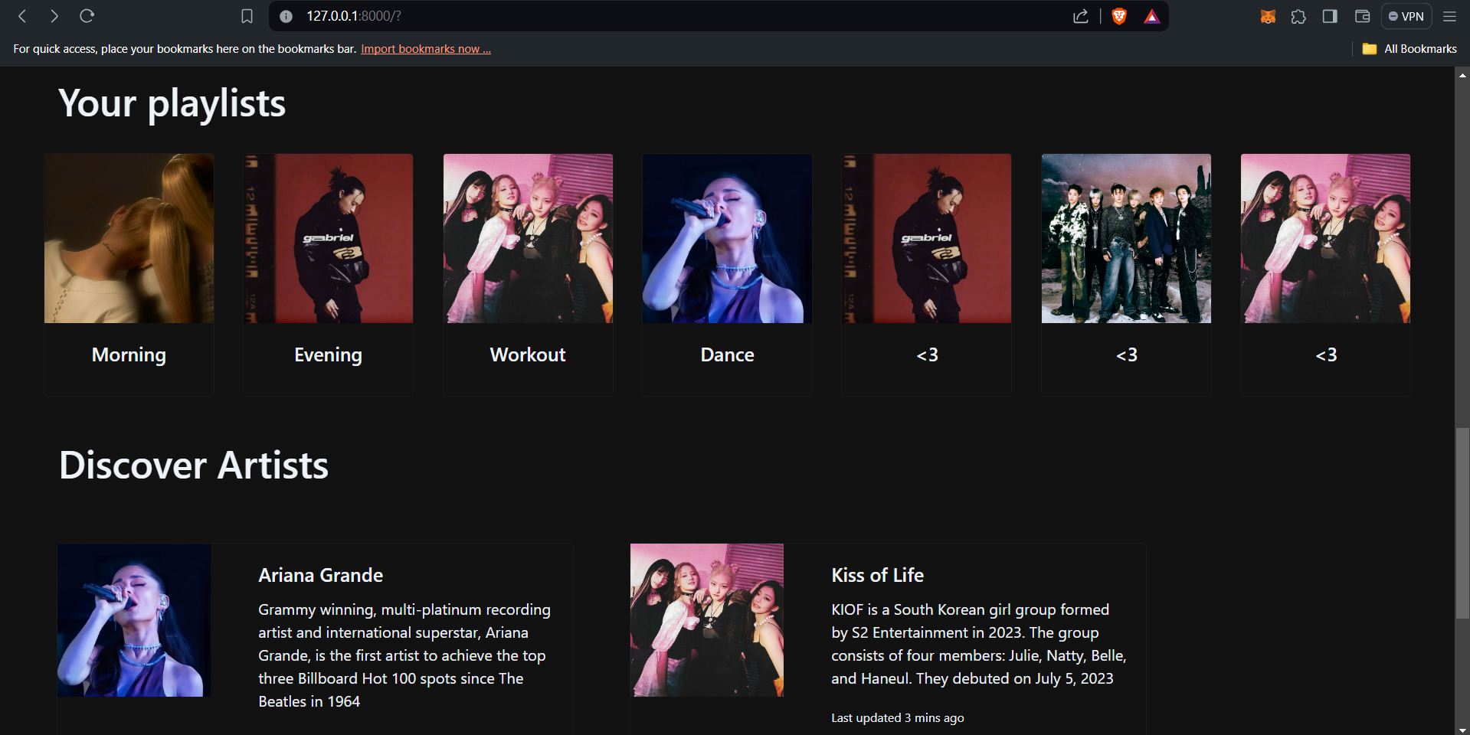

Slide 14
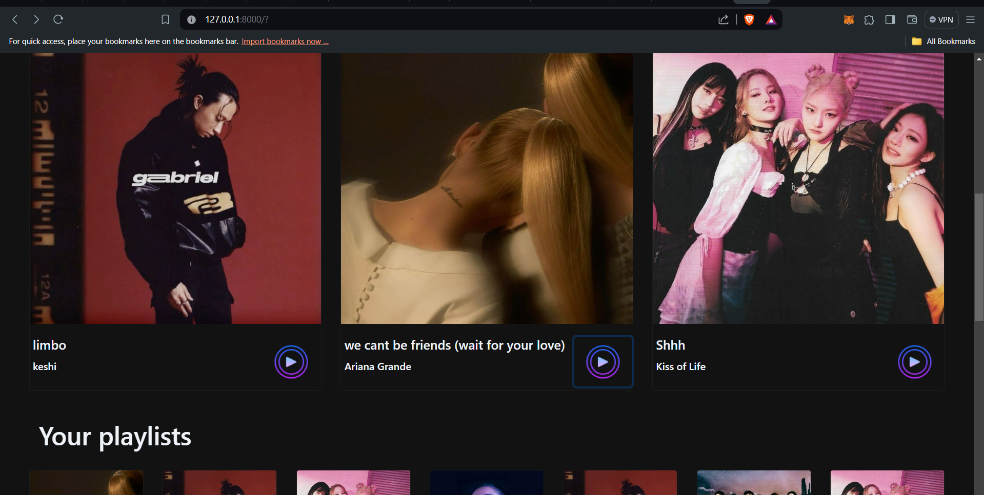

Slide 15
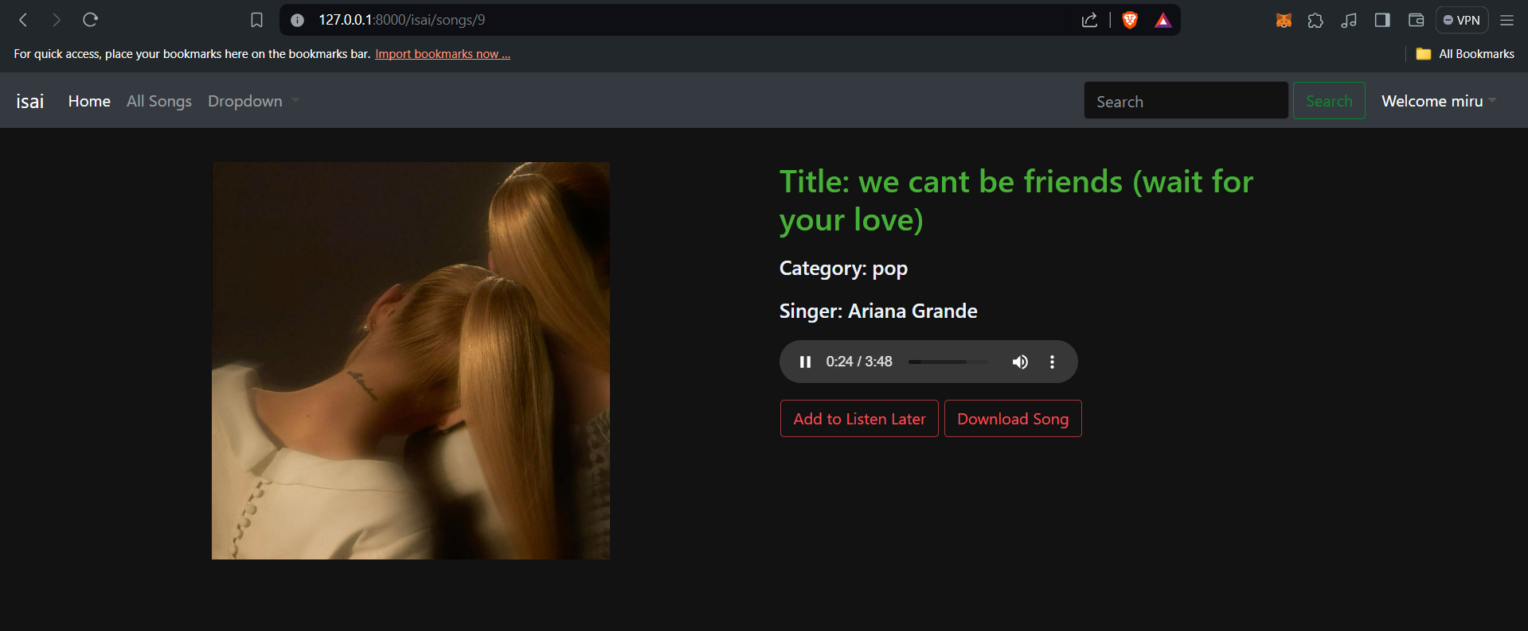

Slide 16
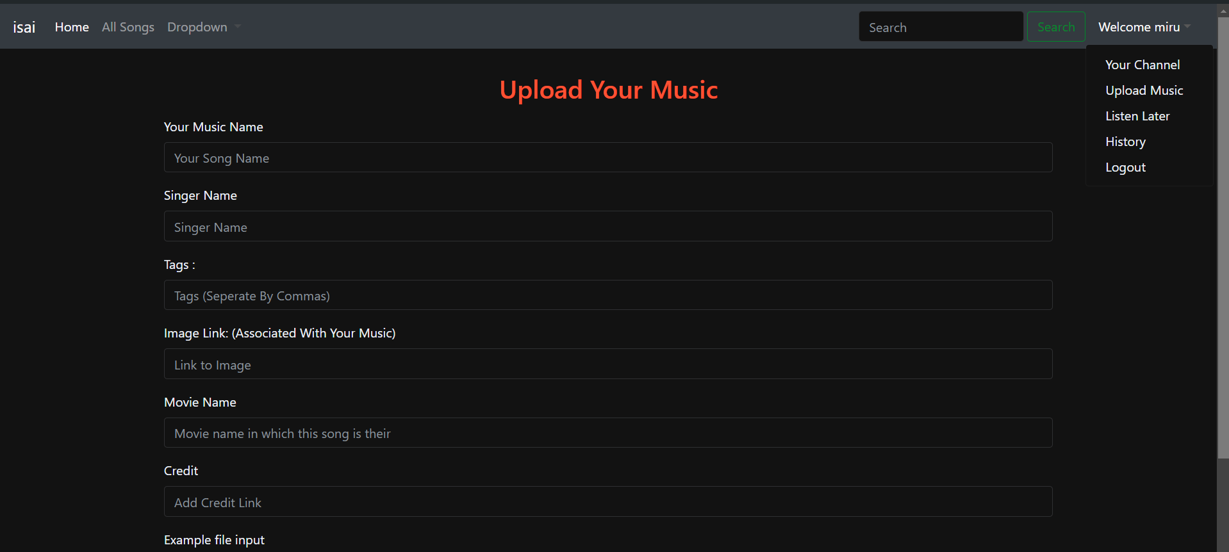

Slide 17
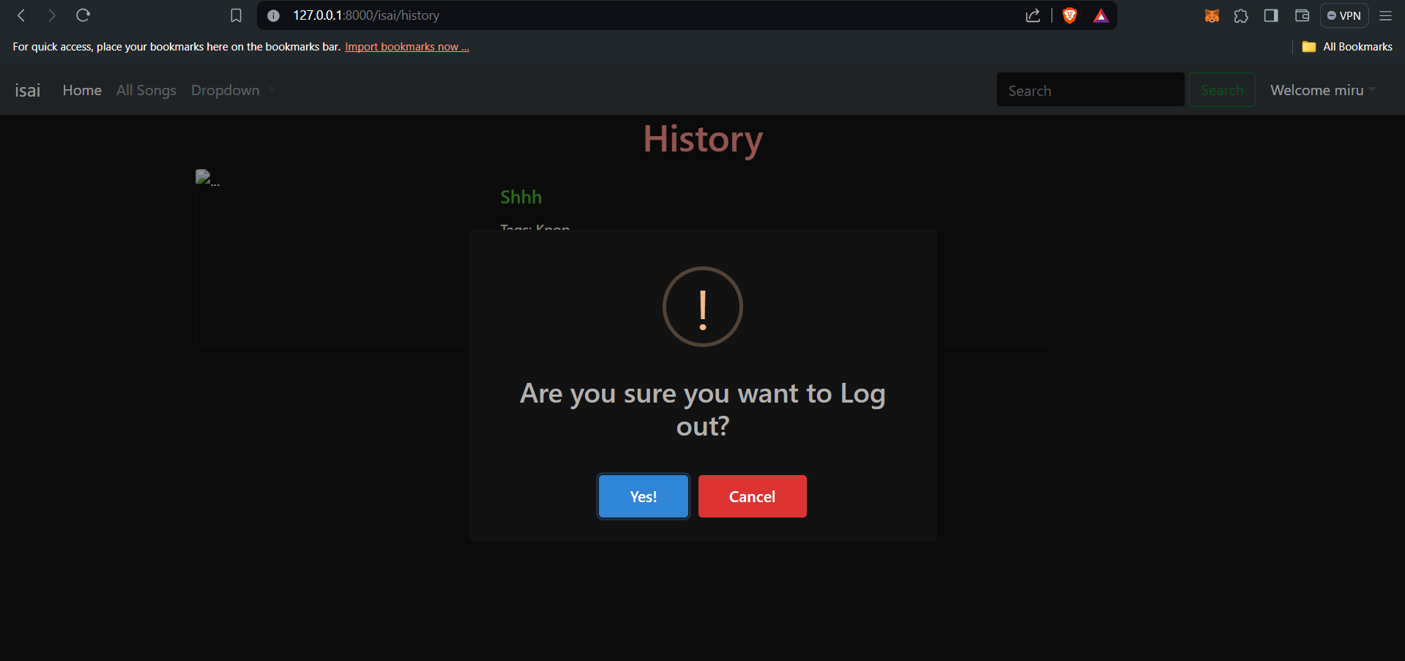

Slide 18
Future Enhancements:
Personalized Recommendations: Implement advanced algorithms to analyze user listening habits, preferences, and contextual data to deliver personalized music recommendations. This will enhance the user’s music discovery experience by suggesting songs and artists aligned with their tastes.
Enhanced Discovery Tools: Introduce innovative tools such as interactive maps that highlight local music scenes, virtual concerts, or immersive experiences. These tools will enable users to explore new genres and artists, enriching their music discovery journey.
Music Education Resources: Incorporate educational resources like tutorials, instrument lessons, music theory quizzes, and interactive challenges. These resources will help users deepen their understanding of music and improve their musical skills.
Voice Control and Integration: Enable voice-controlled commands for a hands-free user experience. Users can search for songs, control playback, and navigate the app using voice commands, making the application more accessible and user-friendly.
These features aim to provide a more comprehensive and engaging music experience, addressing the needs of diverse users and enhancing overall user satisfaction.

Slide 19
Conclusion
In summary, the creation of a music web application using the Django framework offers a solution to the current challenges and gaps in the online music scene. By harnessing Django’s powerful features and incorporating personalized playlist creation, custom recommendations, and social interaction features, the proposed solution aims to deliver a seamless and engaging music discovery experience to users. The application, with its intuitive user interfaces, responsive design, and efficient backend infrastructure, aims to simplify music streaming, organization, and community engagement. Moreover, the project will emphasize continuous improvement through user feedback and iterative development, ensuring the application stays relevant, secure, and capable of addressing evolving user needs. Ultimately, the proposed solution has the potential to transform how users discover, enjoy, and interact with music online, cultivating a lively and dynamic community centered around shared musical interests.
Source :

Slide 20
Thank You!
Notes:
Thank You !!

